Slide 1
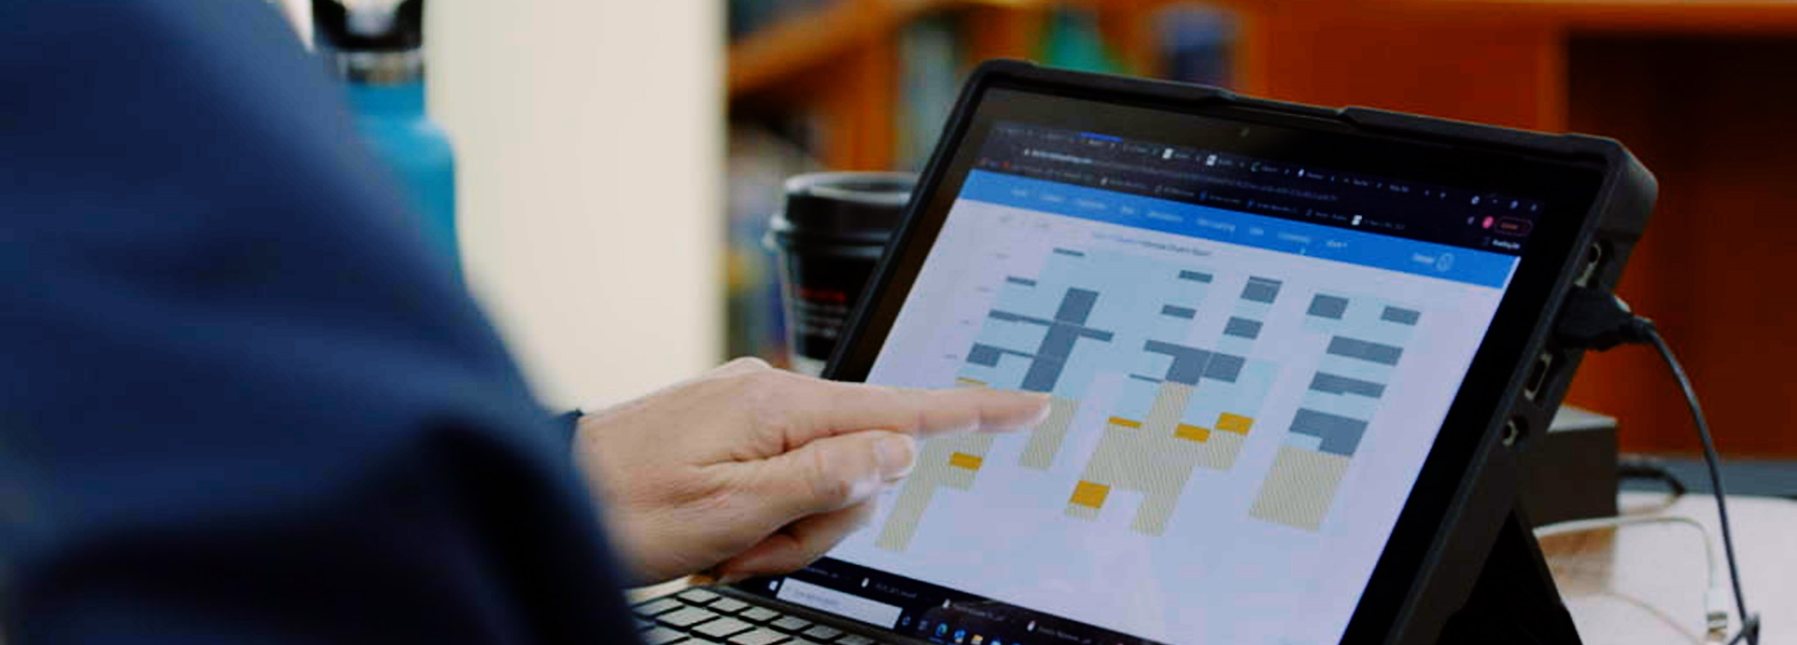
Getting Started with
Maths Pathway Home

Slide 2
How to use this lesson
A great way to get started with Maths Pathway Home!
Print out these 7 pages (ctrl + click to follow the link)
Work through this PowerPoint with your parent or carer
If you have siblings, you can all do this lesson together
Have scissors and a pen/pencil ready to use

Slide 3
Part 1 – Does maths have only one ‘correct’ order?

Slide 4
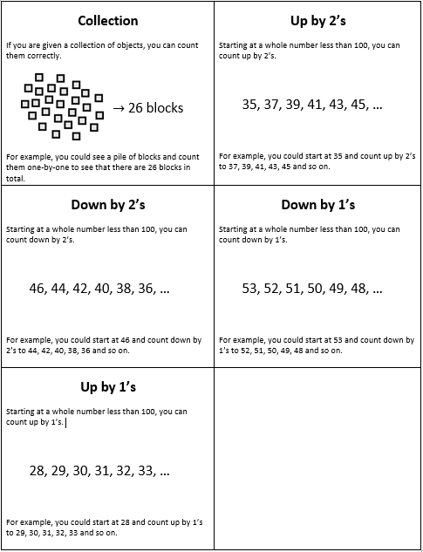
Imagine…
You want to teach a younger child about counting.
You think of some different types of counting.
To help you plan, you make one card for each type.
What order should you teach these in?
Instructions: 1. Cut out these five cards (from the print-out)
2. Arrange the cards in order

Slide 5
More than one right answer
Down
by 2’s
Down
by 2’s
Up
by 2’s
Down
by 1’s
✓
or
✓
Down
by 1’s
Up
by 2’s
Up
by 1’s
Up
by 1’s
Collection
Collection

Slide 6
Actually, it’s not just a simple line.
It’s a whole map.
Down
by 2’s
Down
by 1’s
Up
by 2’s
Up
by 1’s
Collection

Slide 7
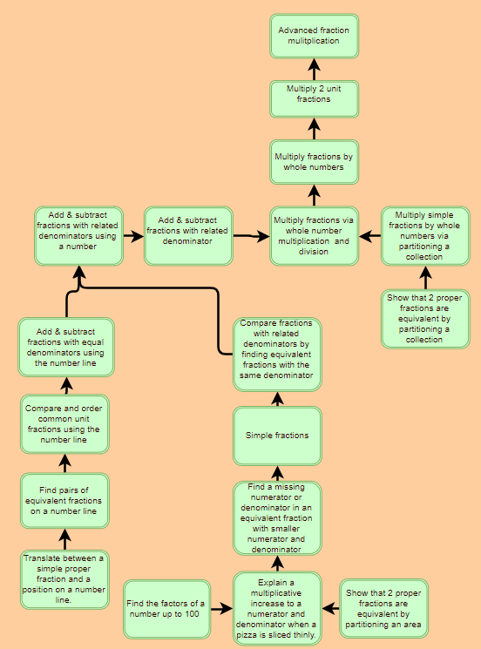
For your maths learning there is also a map
Here is just one small part of that map.
The whole map is too advanced to show in one picture.

Slide 8
Part 2 – What is a ‘diagnostic’?

Slide 9
Imagine…
You want to teach another child about counting
But you don’t know where they are up to in their learning.
You work out what they are ready to learn next using a diagnostic.
The learner answers some questions. By looking at their answers, you can work out what they are ready to learn next.
Instructions: Fill in the worksheet titled “What are they ready
to learn next?” from the print-out
Do this by: 1. Look at each child’s diagnostic in the print-out
2. Tick what each child already knows how to do
3. Circle what each child is ready to learn next

Slide 10
Answers: coming up on the next slide…

Slide 11
Answers:
Ming
Down
by 2’s
Down
by 1’s
Up
by 2’s
Up
by 1’s
Collection

Slide 12
Answers:
Zane
Down
by 2’s
✓
✓
Down
by 1’s
Up
by 2’s
Up
by 1’s
✓
Collection
✓

Slide 13
Answers:
Aba
There are two things which Aba could learn next.
Down
by 2’s
Down
by 1’s
Up
by 2’s
✓
Up
by 1’s
Collection
✓

Slide 14
Answers:
Clinton
Clinton is not ready to learn counting down by 2’s yet.
He should learn how to count up by 2’s first.
Down
by 2’s
Down
by 1’s
✓
Up
by 2’s
Up
by 1’s
✓
Collection
✓

Slide 15
Answers:
Aarushi
Aarushi already knows all of these things.
She must be ready to learn something different!
Down
by 2’s
✓
✓
✓
Down
by 1’s
Up
by 2’s
Up
by 1’s
✓
Collection
✓

Slide 16
Soon you will do your own diagnostic
Let’s work out what you are ready to learn next in mathematics.
You will do a diagnostic yourself. This is more advanced than the simple diagnostic we’ve just looked at.
You do it on a computer
It covers a huge amount of mathematics in one go
There are more questions, so single mistakes won’t matter
Your login details will arrive soon!

Slide 17
Part 3 (Optional) – Sneak peek of what comes next…

Slide 18
Sneak peek of what comes next…
When your login details arrive, they come with a video showing you what happens next.
If you’d like a sneak peek at that video right now, click on the link below:
Video: First steps after login
(ctrl + click to follow the link)

